Slide 1

Agile Review Final Project Charles C. Campbell SNHU CS-250

Slide 2
Agenda
Explaining Agile Roles
Explaining Agile Phases
Describing Waterfall Model
Waterfall or Agile Approach
References

Slide 3

Explaining Agile Roles

Slide 4
Agile Roles for a Scrum Team
Product Owner:
Manages Product Backlog
Interacts directly with stakeholders/customers
Maintains product vision & market strategy
Provides direction to the team from user stories/clients perspective
Scrum Master
Servant Leader for the development team
Mentor, Teacher & Coach to team members
Facilitates & plans out Scrum events
Works with the development team & removes impediments to team’s progress
Team Member:
Cross-functional & self-organizing team player committed to work collaboratively with others
No sub-teams, all members work equally on any task required
Can offer different perspectives and innovates with others so all can learn and grow new skills
Utilizes their unique skills and abilities (like testing or developing code) to help the single team unit succeed
“Scrum offers a framework that catalyzes teams’ learning through discovery, collaboration, and experimentation. Within Scrum, self-organizing, cross-functional, and highly productive teams do the work: creating valuable releasable product increments” (Overeem, 2016).

Slide 5



Explaining Agile Phases

Slide 6
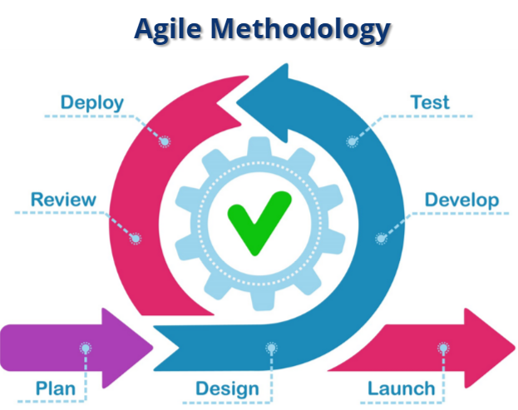
Explaining Agile Phases
“These events are specifically designed to enable the transparency required in the Agile Manifesto. Failure to operate any events as prescribed results in lost opportunities to inspect and adapt” (Schwarber & Sutherland, 2020).
Product Owner receives input from customers / management / executives & creates product backlog.
Sprint Planning meeting, where the entire team reviews backlog items, identifies what and how work will be done, and sets attainable goals.
Daily stand-up (everyday 15 min meeting in the morning) is held to ensure all team members know what is complete and what needs to be done.
Design/Development & Testing are done at the same time during a “Sprint” (1-4 week(s) long time to accomplish all items on backlog).
The Sprint Review gives the completed items in the Sprint to the customers / business management so oppenness and open feedback on accomplishments can flow between team and clientele.
Sprint Retrospective concludes the Sprint, and allows the team to evaluate individual efforts, processes, tools used, and the project’s ‘Definition of Done’.
Phases 1-6 are done repeatedly until the product meets required criteria. Once the ‘Definition of Done’ is met, a high-quality, completed artifact is launched.
Product Owner receives input from customers / management / executives & creates product backlog
Sprint Planning meeting
Figure: Agile Methodology Model
Retrieved from: https://snhu-media.snhu.edu/files/ course_repository/undergraduate/cs/cs250/storyline/mod1/story_html5.html

Slide 7

Describing the Waterfall Model

Slide 8
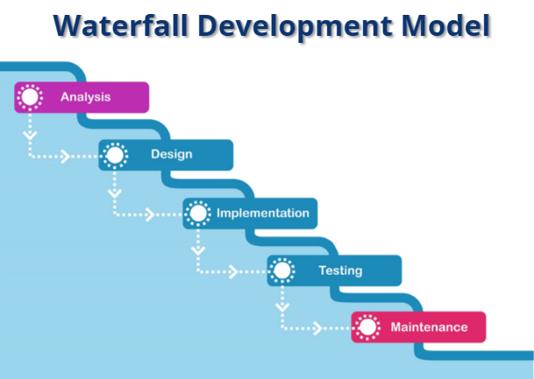
Describing the Waterfall Model
The waterfall method, ironically, is very strict in the planning, development, and retrospective of products.
Planning is done all up-front, customers and stakeholders are often left out until the very end of development; little to no interaction with the product until the end.
Teams resist new requirements, or continuously and incorrectly document the addition of new features which adds more work, extends deadlines, and goes over pre-planned project budget.
Testing is held until the end of the development cycle, by then the risk is high and the huge investment/efforts can be discounted if defects are found; the end result becomes a rare complete success, or too often an absolute failure (Morgan, 2018, pg.1-2).
Figure: Waterfall Development Model
Retrieved from: https://snhu-media.snhu.edu/files/ course_repository/undergraduate/cs/cs250/storyline/mod1/story_html5.html

Slide 9

Waterfall or Agile Approach

Slide 10

Agile vs. Waterfall Which is better?
The transition from the waterfall tradition to the agile methodologies might seem daunting, and resource-heavy…
However, the results from Agile show that future projects can be well maintained, documented, reduces overall cost and production time, and boosts collaboration in teams. Additionally, it’s methods allow for changes, which can often happen. The market can alter over time, business priorities can often change, and people change their minds as well.
“According to the 2012 CHAOS [Comprehensive Human Appraisal for Originating Software] report, Agile succeeds three times more often than Waterfall. Agile methodologies helps companies work more efficiently and delvier winning results, Agile adoption is constantly increasing” (Cobb, 2015, pg. 3).
Waterfall’s methods take longer to plan, it’s very rigid, hardly ever allows new additions or changes in product vision/direction, and doesn’t allow customer feedback until after the final iteration of testing and the full release of a product.
Agile is becoming more and more of the standard in the modern day. Agile takes what was good about the Waterfall methodologies, and expounds upon it. It’s results are seen in delivering a high-quality end products; and focuses on the values of collaboration, openness, and transparency that builds trust between team members and between the project’s customers / stakeholders.

Slide 11
References
Charles G. Cobb. (2015). The Project Manager’s Guide to Mastering Agile : Principles and Practices for an Adaptive Approach. Wiley.
Morgan, J. D. (2018). Applying 1970 Waterfall Lessons Learned Within Today’s Agile Development Process. PM World Journal, 7(7), 1–19.
Overeem, B. (2016, APR 15). Characteristics of a Great Scrum Team. infoq.com. Retrieved from: https://www.infoq.com/articles/great-scrum-team/
Schwaber, K., & Sutherland, J. (2020). The 2020 Scrum Guide. Scrum Guide | Scrum Guides. https://scrumguides.org/scrum-guide.html

